Slide 1
Supervised Learning in ML

Slide 2
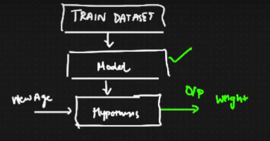
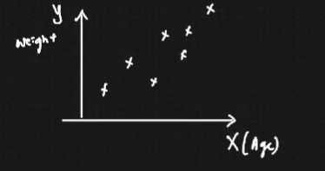
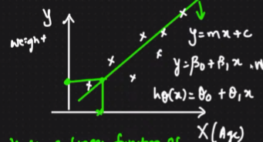
Linear Regression
y is a linear function of x.

Slide 3
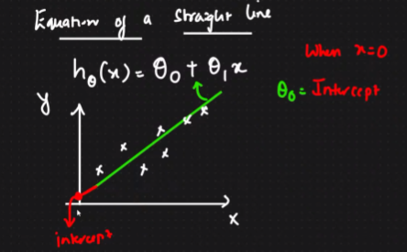
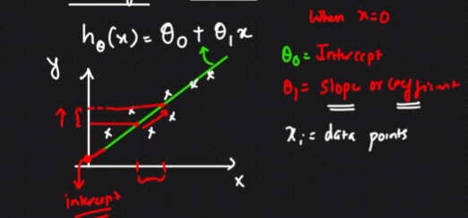
Linear Regression

Slide 4
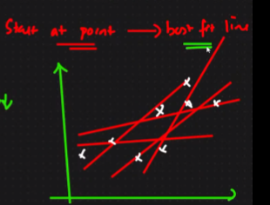
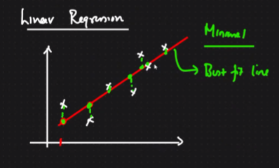
Linear Regression

Slide 5
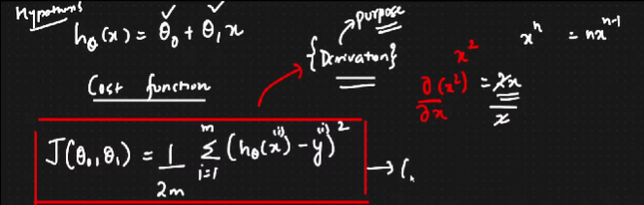
Linear Regression: Cost Function or Squared Error Function

Slide 6
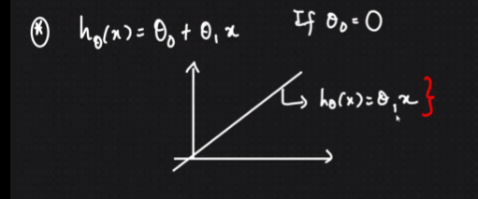
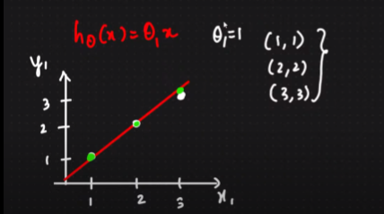
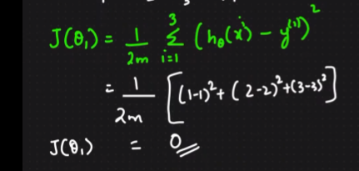
Linear Regression : Intercept=0

Slide 7
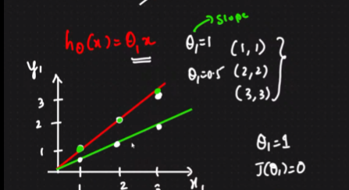
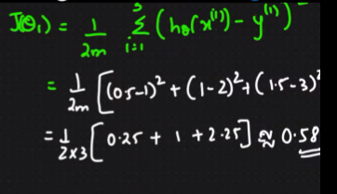
Linear Regression : Intercept=0.5

Slide 8
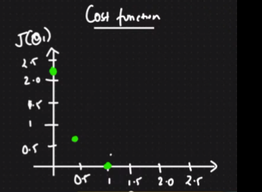
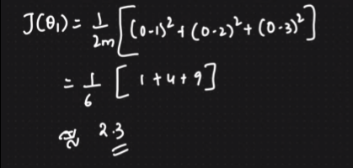
Linear Regression: Cost function

Slide 9
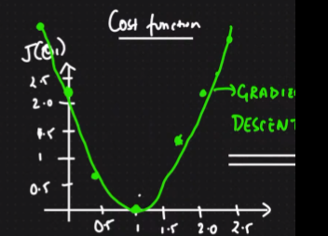
Linear Regression: Gradient Descent, Global Minima
https://www.ibm.com/cloud/learn/gradient-descent#:~:text=Gradient%20descent%20is%20an%20optimization,each%20iteration%20of%20parameter%20updates.

Slide 10
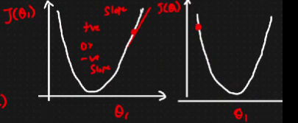
How to select theta value to reach to the global minima?
Convergence Algorithm: Once you reach a certain point, the idea is to come to the global minima.
Repeat until convergence
Keep updating theta values

Slide 11
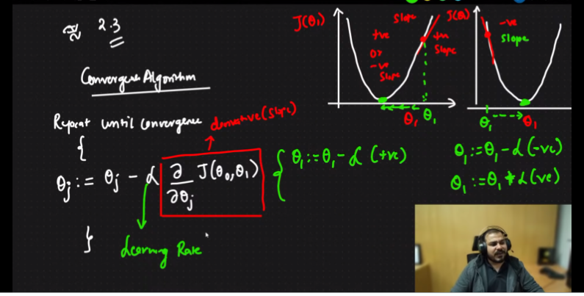

How to select theta value to reach to the global minima?
In order for Gradient Descent to work, we must set the learning rate to an appropriate value. This parameter determines how fast or slow we will move towards the optimal weights.

Slide 12
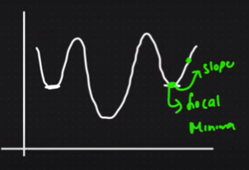
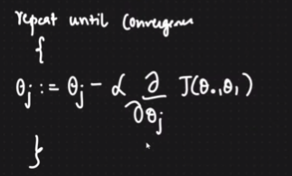
What if the cost function has some local minima?
Gradient Descent Algorithm

Slide 13
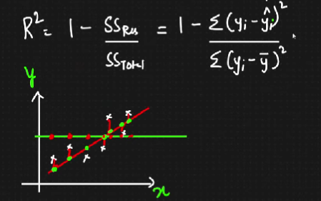
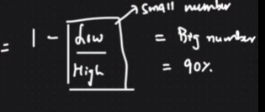
Performance Metrics : R square and adjusted R square

Slide 14
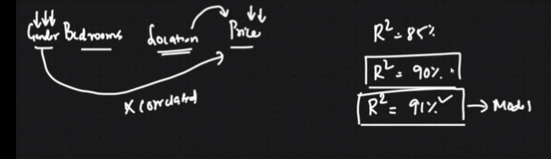
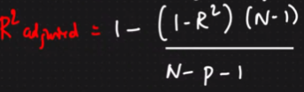
Performance Metrics : adjusted R square
N = number of records/samples/ data points
p = number of features

Slide 15
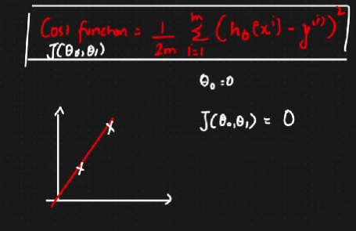
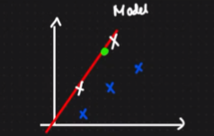
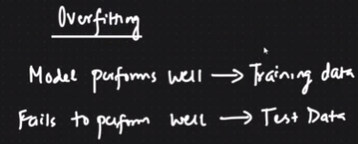
Overfitting : Bias and Variance
Bias is the amount that a model’s prediction differs from the target value, compared to the training data.

Slide 16
